Slide 1
PowaFinance
Book used for reference: https://www.oreilly.com/library/view/building-microservices-2nd/9781492034018/
Daniil’s personal notes which he makes while reading the book: https://docs.google.com/document/d/1jilfJR9OmyrUXzp-0dwDkjFsh4RmiisBhNVMydC3mhc/edit?usp=sharing

Slide 2
Product description
Our product is Android App which purpose to ease up tracking of expenses. Though there are plethora of similar apps there are certain features that differentiate it:
ML model to project expenses for the next quarter
News API to fetch most applicable financial news
Investing API to give user option to invest in the desired stocks/bonds
Sleek design compared to competitors

Slide 3
Event storming
From my understanding it is an activity during which technical and non-technical stakeholders decide how to design a microservice.
Steps:
identify domain events
identify commands that trigger events
define aggregates
group into bounded contexts
In our case we used persons (polling) to ask for the needs of such app and whether they even have interest in finances. Based on the answers we found out the pet-peeves. I.e.: 1. not enough info about finance industry 2. clunky apps.

Slide 4
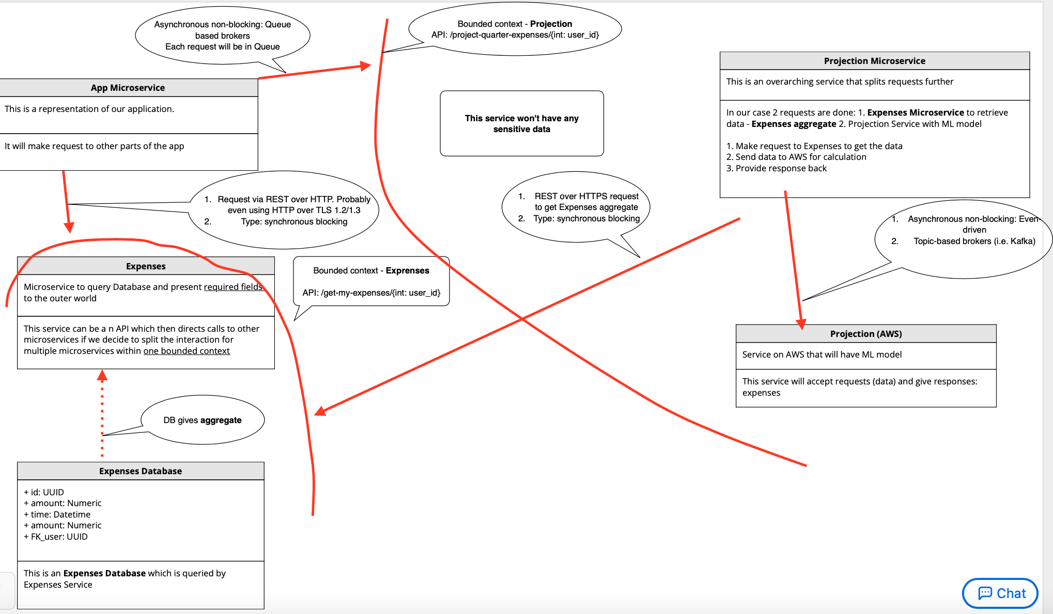
Service diagram (production-alike modeling)
Part is implemented here as initially this was my draft
Next page is more academia-like

Slide 5
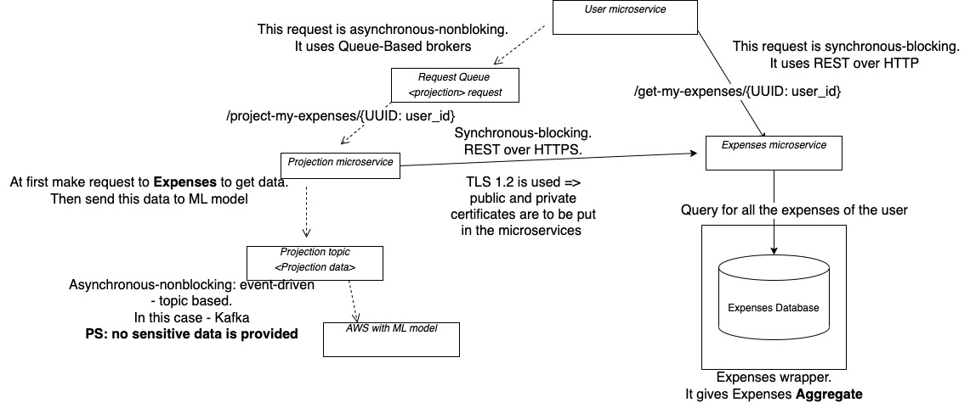
Service diagram (more formal version)

Slide 6
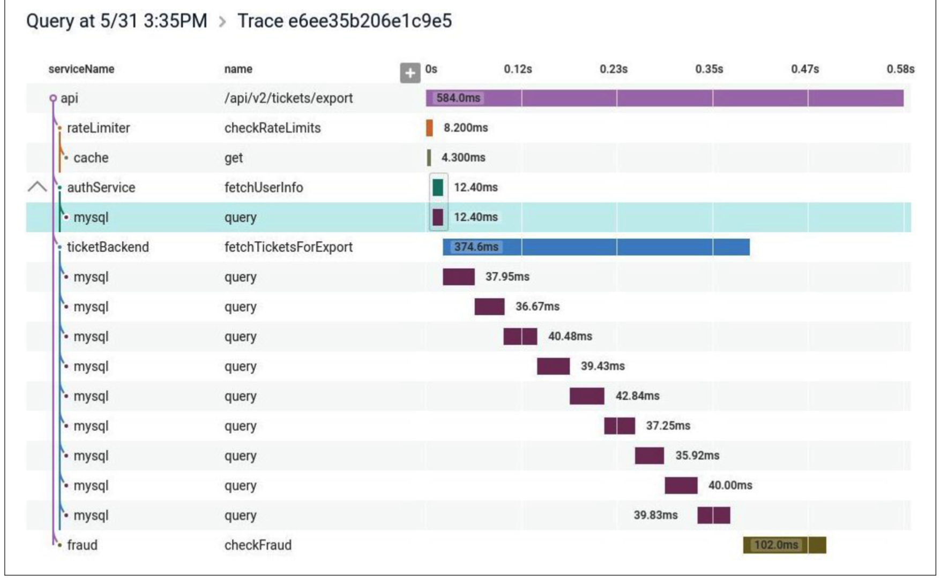
Traceability
From my understanding traceability is part of Observability. It comprises logs, metrics, tracing. Tracing allows us to see the flow in case of many microservices and see how it goes (not simple correlation ID). It has standard: older – Open Tracing, newer – Open Telemetry.
We’ll use Honeycomb as the most popular and effective tracing tool. Below you can see example of this app:

Slide 7
Expected technology
In case of technologies, we use:
Our app will be written in:
Backend: Java 11 + Spring, Postgres as DB, Kubernetes for deploy
Mobile: Kotlin
For asynchronous-nonblocking communication:
event-driven communication: Kafka
request-response: queue-based brokers
Synchronous-blocking communication:
request-response: REST over HTTP (in our case highly likely simple HTTP, not HTTP over TLS)

Slide 8
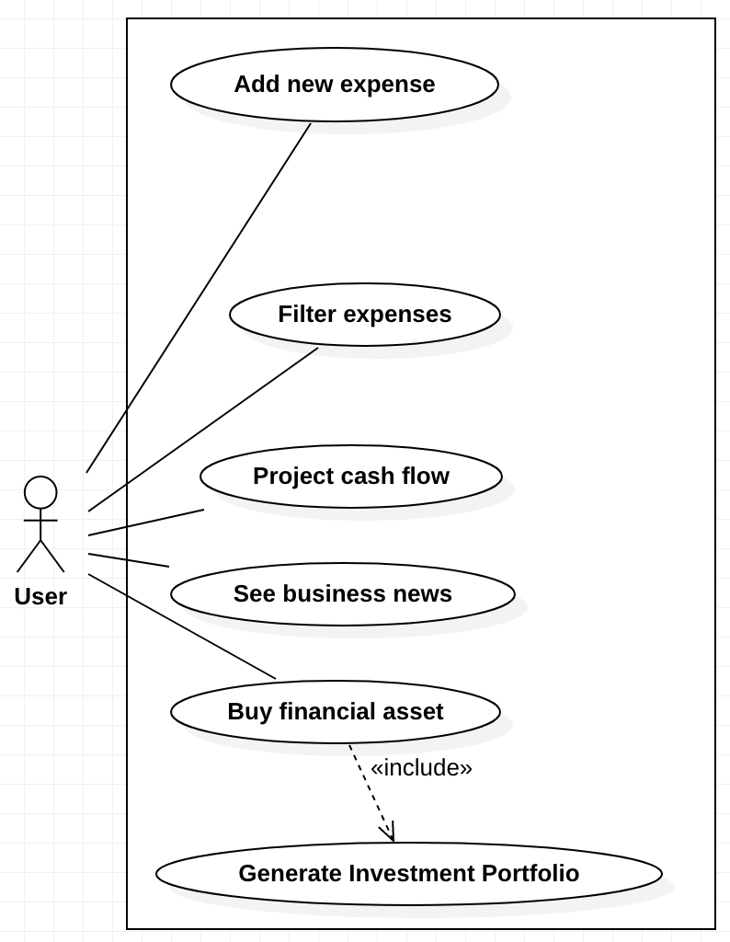
Use case diagram

